Slide 1
Good Morning WSLI!
Today we will discuss the framework of being an
Abolitionist
by Shaunte Johnson of Inner Enso

Slide 2
Race & Racism Round 1
Please share your response to the following prompt in the chat:
On a scale of 0-5, how comfortable are you talking about race/racism? Explain.
0 = I would rather not talk about race/racism.
1 = I am very uncomfortable talking about race/racism.
2 = I am usually uncomfortable talking about race/racism.
3 = I am sometimes uncomfortable talking about race/racism.
4 = I am usually comfortable talking about race/racism.
5 = I am very comfortable talking about race/racism.

Slide 3
2-Minute Breathe Bubble

Slide 4
You can’t create new ways of being with old patterns of behavior
Be kind
Be aware of your privilege & positionality
Be a compassionate listener
Be open to learning
Be brave
Be present in your discomfort
Be willing to critically examine your existing beliefs
Be conscious of what patterns of behavior you cling to
This presentation was created and curated by Tymmony Keegan, 10th grade Humanities Teacher and Abolitionist educator at Cleveland STEM H.S.

Slide 5
Founded by Shaunte & Anthony Johnson in 2018
Powered by a culturally diverse network of professionals, athletes & social influencers who leverage their experiences to create compelling content
Promoting racial equity through the lens of Abolitionist teaching
© 2021 Inner Enso. All Rights Reserved.
Notes:
Shaunte & Anthony are former educators (teacher, guidance counselor, intervention and behavior specialist), professional athletes, and community advocates.

Slide 6
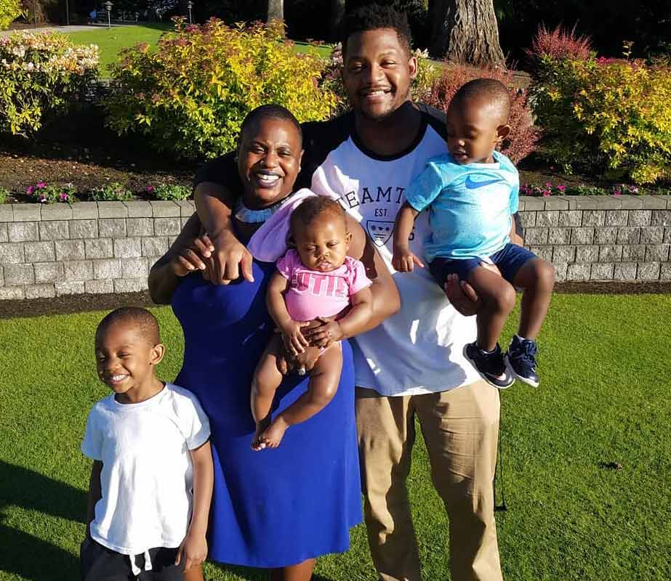
© 2021 Inner Enso. All Rights Reserved.
Notes:
Shaunte & Anthony are former educators (teacher, guidance counselor, intervention and behavior specialist), professional athletes, and community advocates.

Slide 7
OUR MISSION
“We believe through authentic connections, compassion, and storytelling we can provide a compelling DEI experience that will radically change educational systems.”
-INNER ENSO
© 2021 Inner Enso. All Rights Reserved.

Slide 8
Brought to you by

Slide 9
What is Abolitionist Teaching?
The practice of working in solidarity with communities of color while drawing on the imagination, creativity, refusal, (re)membering, visionary thinking, healing, rebellious spirit, boldness, determination, and subversiveness of abolitionists to eradicate injustice in and outside of schools.
Source: Dr. Bettina L. Love, We Want to Do More Than Survive - Abolitionist Teaching and the Pursuit of Educational Freedom

Slide 10
We will position ourselves to be educated about race, and participate in meaningful discussions, while being emotionally supported about a topic that can be uncomfortable .
© 2021 Inner Enso. All Rights Reserved.
Copyright 2021

Slide 11
STAGE 1 AWARENESS (Identifying Truth):
Becoming comfortable with talking about race
Vocabulary
Storytelling of field experts
Families personal experiences beauce they are the true experts
Elders’ stories about the history of race in the area you serve.
© 2021 Inner Enso. All Rights Reserved.

Slide 12
We will understanding our impact on the people that we effect and how to adopt an abolitionist mindset.
© 2021 Inner Enso. All Rights Reserved.

Slide 13
STAGE 2 ACCEPTANCE: (The Pushback)
Understanding and knowing about the problems our families face
Identifying my own personal biases
Statistics and data that dismantle those narratives we once held
Amplifying the BIPOC family voices
© 2021 Inner Enso. All Rights Reserved.

Slide 14
I can see Abolitionist mindset in my own space, I can identify areas for celebration, and areas for further growth. Your families will become your leaders.
© 2021 Inner Enso. All Rights Reserved.

Slide 15
STAGE 3 ACTION (The Shift):
Refining the information in the past two stages to create meaningful and lasting change using Abolitionist teaching as a foundation
Strengthen Abolitionist mindset
Create customized strategies around talking about race and healing
Create a team to help push continuous education in your work spaces and self
Collaborate with local BIPOC organization, professionals, families to enhance and support the work
© 2021 Inner Enso. All Rights Reserved.

Slide 16
Let’s Chat BREAK OUT SESSION:
Please remember our Way of being!
Questions:
What stage of am I doing well at? (Awareness, Acceptance, Action)
What stage can I work to better support my families of color?
What will I do to ensure Im a better advocate for BIPOC families?
© 2021 Inner Enso. All Rights Reserved.

Slide 17
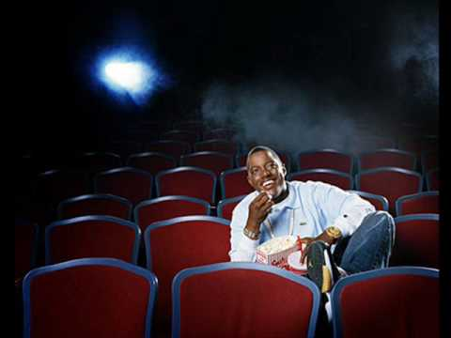

Slide 18
Chat Box: 5 min
Please share in the chat:..
What information was helpful to hear during your breakout room?
What area in the framework will you focus on adding to the current work you do now?
What do you need to be able to develop a stronger Abolitionist mindset?
Notes:
Welcome Back!

Slide 19
ACTIVITY (? minutes)
Please share out a response that was shared by one of your colleagues that moved you?

Slide 20
shauntenj@innerenso.com
innerenso.com
© 2021 Inner Enso. All Rights Reserved.

